Slide 1
Stop manually publishing your PowerShell modules
Daniel Schroeder
@deadlydog
1 / 15

Slide 2
Keep this here and replace it with the update sponsor image that will be sent out the week prior to summit

Slide 3

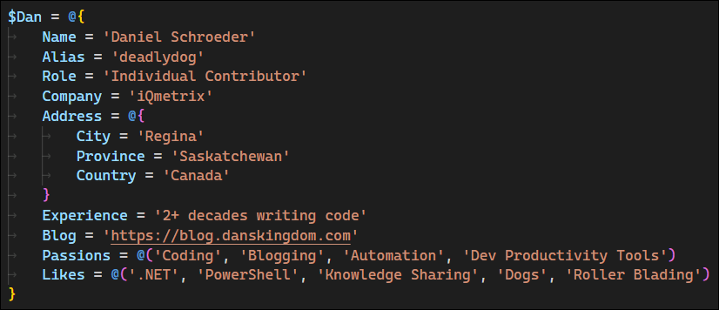
About Dan
Notes:
- @deadlydog
- Individual Contributor at iQmetrix
- Writing software for over 2 decades
- Blogging for over a decade: https://blog.danskingdom.com
- Passionate about automation and developer productivity tools

Slide 4
Agenda

Slide 5
Agenda

Slide 6

THANK YOU
Please review this session

Slide 7
Heading

